Slide 1
Domestic Food Manager _ Role Presentation [DB-MyBatis & MySQL]
Produced by Mun

Slide 2
Chart
Role Outline
E-R Diagram
Study [MyBatis]
Schedule

Slide 3


Role Outline.
“Design Data Base using MyBatis & MySQL”
X
Connection
between Spring & DB
Implementation DB
(Written Query)

Slide 4
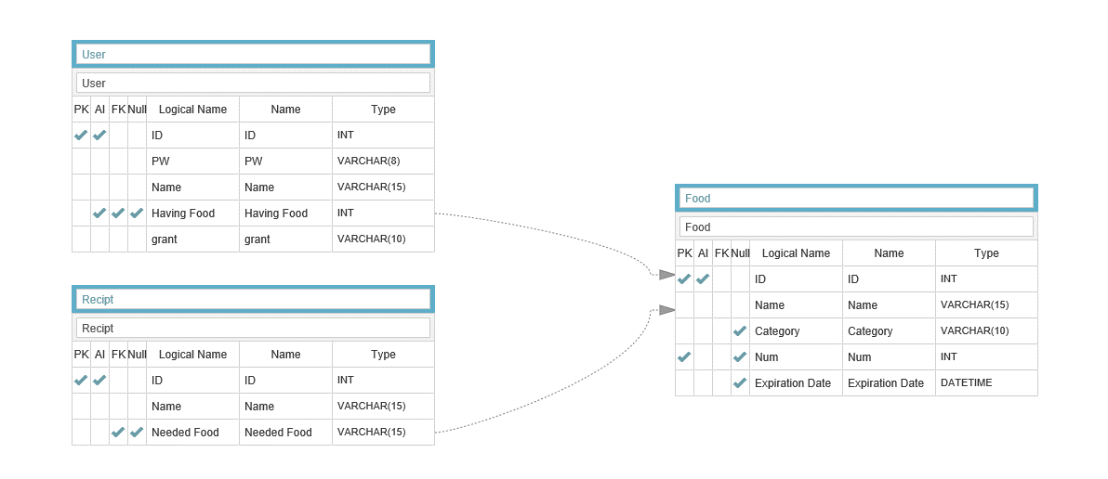
E-R Diagram

Slide 5
Study MyBatis

Slide 6
Schedule

Slide 7
Get Feedback

